Slide 1
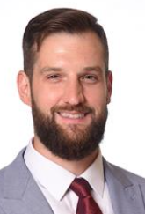
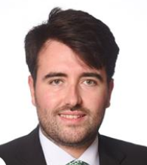
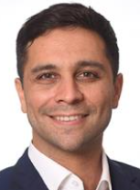
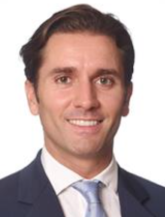
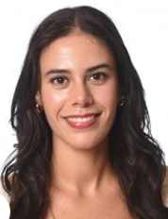
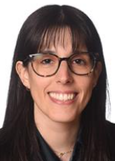

Organizational chart
Team Number | Team Name | World
3 | AirFlow Six | A
CEO
Name | Harel Lichtenstein
Email | Harel.Lichtenstein@iese.net
Phone | +34644266452
Insert Photo here
CFO
CMO
COO
CLO
CPO - Ctrl
Insert Photo here
Insert Photo here
Insert Photo here
Insert Photo here
Insert Photo here
Function | Finance | Marketing | Operations | Logistics | People / Controller
Name | Sergi Cercós | Tomas Tapia | Pedro Hermida | Aya El Haraboui | Cristina Navarro
Email | sergi.cercos@iese.net | tomas.tapia@iese.net | pedro.hermida@iese.net | Aya.elrharbaoui@iese.net | cristina.navarro2@iese.net
Phone
Sustainability* | X
Purchasing* |  |  | X
*Mark with X who assumes this function (CMO, COO, CLO or CPO/Controller)

Slide 2
Team Contract
Team Number | Team Name | World
3 | AirFlow Six | A
Mission as Management Team:
AirFlow Size will operate as a unified Committee, where transparency supersedes siloed departmental goals. We prioritize collective solvency over individual optimization, fostering a culture where "bad news travels fast" so bottlenecks in cash flow or capacity can be addressed immediately.
Above all, a spirit of collaboration is promoted to maximum shareholder value
Goals as a Team:
Maintain positive Initial and Subperiod Cash Flows at all times to strictly avoid the Emergency Loan mechanism. We recognize that the 30% interest rate penalty signals financial mismanagement to the Board and destroys shareholder value
Strictly adhere to the Board’s requirement of a 15% annual reduction in emissions intensity. Sustainability is not a cost, but as a condition for our "license to operate.”
We aim to secure signed agreements with both the Bank and the Unions by preparing data-backed negotiation decks that proactively address their constraints
We aim to explicitly identify and document the trade-offs made in each period (e.g., "We sacrificed short-term cash for long-term ESG compliance") to demonstrate strategic depth in our final Master Thesis

Slide 3
Team Contract
Team Number | Team Name | World
3 | AirFlow Six | A
Team Rules - Norms: meeting rules, decision making, feedback, conflict management…
Following every simulation period (whether Trial or Real), we commit to a 30-minute debrief to analyze deviations between Planned vs. Actual results. The focus will be on fixing the decision model, not assigning personal blame
Adhere to a "Market-Back" sequence where the CEO-approved Demand Forecast dictates all operational and financial planning
Settle resource allocation disputes by prioritizing the option with the highest projected ROI on the current P&L
Grant the CFO absolute veto power over any departmental expenditure that triggers a negative Initial Cash Flow
Designate specific role owners for final dashboard uploads to prevent data overwriting and version control errors
Enforce mandatory attendance for all ExSim meetings with a strict 15-minute "lock-in" prior to simulator deadlines
Above all, act as a united front and promote collaboration, freedom of expression, promote learning and execution.

